Slide 1
Deploying Azure Resource Manager virtual machines by using Azure Resource Manager templates
Using Visual Studio and an Azure Resource Manager template to deploy virtual machines
Using Azure PowerShell and an Azure Resource Manager template to deploy virtual machines

Slide 2
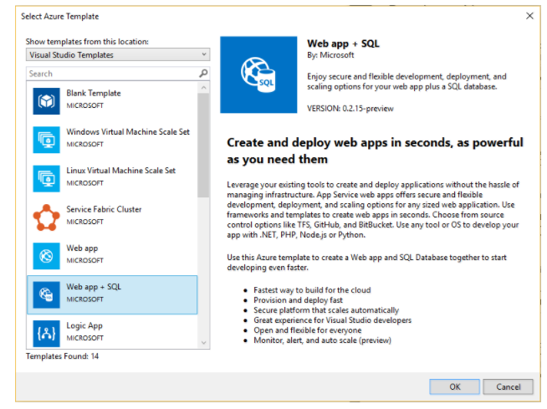
Using Visual Studio and an Azure Resource Manager template to deploy virtual machines
In Visual Studio, choose File, New Project, choose either C# or Visual Basic (which language you choose has no impact on the later stages as these projects contain only JSON and PowerShell content). Then choose Cloud, and Azure Resource Group project.
Choose the template that you want to deploy to Azure Resource Manager. Notice there are many different options based on the type of project you wish to deploy. For this article, choose the Web app + SQL template.

Slide 3
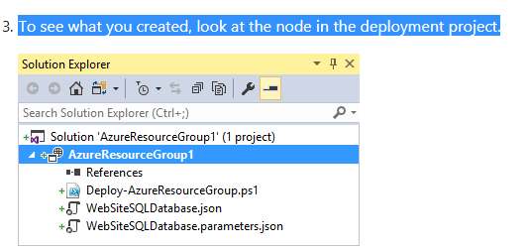
To see what you created, look at the node in the deployment project.

Slide 4
You can customize a deployment project by modifying the JSON templates
that describe the resources you want to deploy. JSON stands for JavaScript
Object Notation, and is a serialized data format that is easy to work with. The
JSON files use a schema that you reference at the top of each file. If you want
to understand the schema, you can download and analyze it. The schema
defines what elements are valid, the types and formats of fields, the possible
values of enumerated values, and so on.
The Visual Studio editor provides tools to assist you with editing the Resource Manager template. The JSON Outline window makes it easy to see the elements defined in your template.
Selecting any of the elements in the outline takes you to that part of the template and highlights the corresponding JSON.

Slide 5
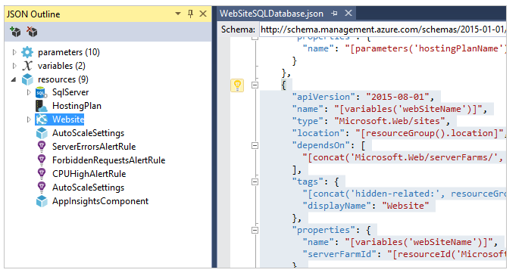

Slide 6
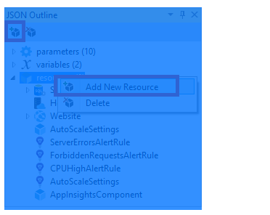
You can add a resource by either selecting the Add Resource button at the top of the JSON Outline window, or by right-clicking resources and selecting Add New Resource.

Slide 7
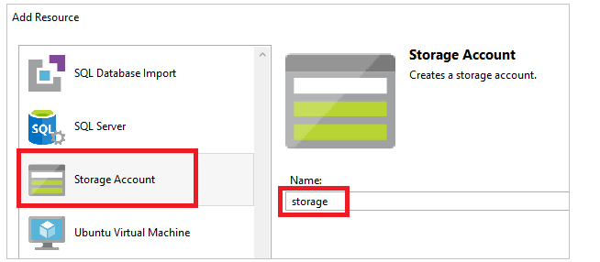
Notice that not only was the resource added, but also a parameter for the type storage account, and a variable for the name of the storage account.
The storageType parameter is pre-defined with allowed types and a default type. You can leave these values or edit them for your scenario. If you do not want anyone to deploy a Premium_LRSstorage account through this template, remove it from the allowed types.

Slide 8
